Slide 1
Week 14-15
Transformer for Image Recognition

Slide 2
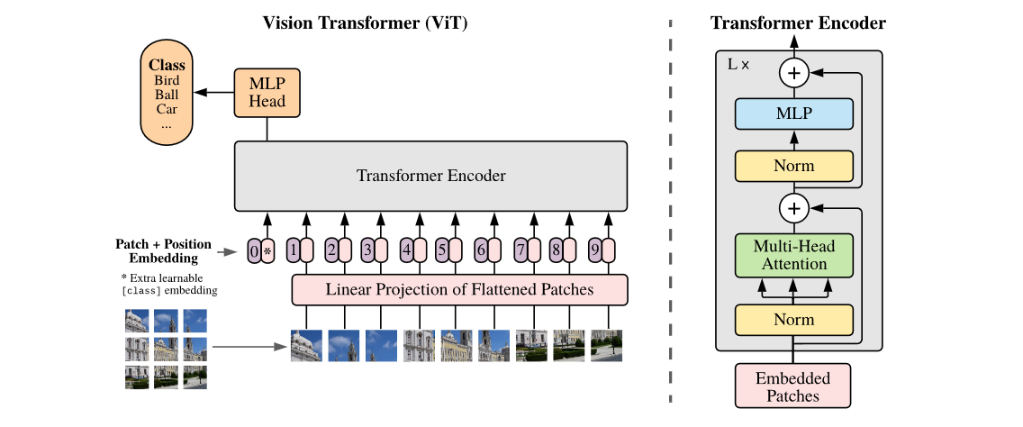
Vision Transformer
Image Procession & Linear Projection
Transformer Encoder
MLP Head

Slide 3
Image Procession & Linear Projection
Position Embedding
0
Class Token
*
1
2
Transformer Encoder
L
…
P
n
addition
image
patches
Linear Projection

Slide 4
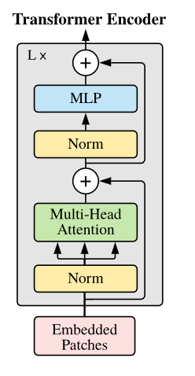
Transformer Encoder
Linear
There is different in ViT’s Transformer Encoder. In Encoder block, the Multi-Head Attention and MLP layer is after LayerNorm
Dropout
GeLU
Linear
MLP Layer

Slide 5
MLP Head
MLP Head just take the first output of Transformer Encoder as input(class token).
But in practice, usually use mean pooling on output.
MLP Head
Transformer Encoder
…

Slide 6
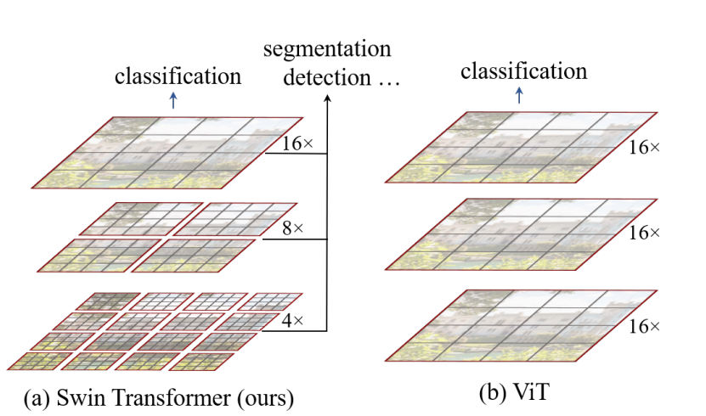
Swin Transformer
Architecture
Window-MSA
Shifted Window
Relative position bias

Slide 7
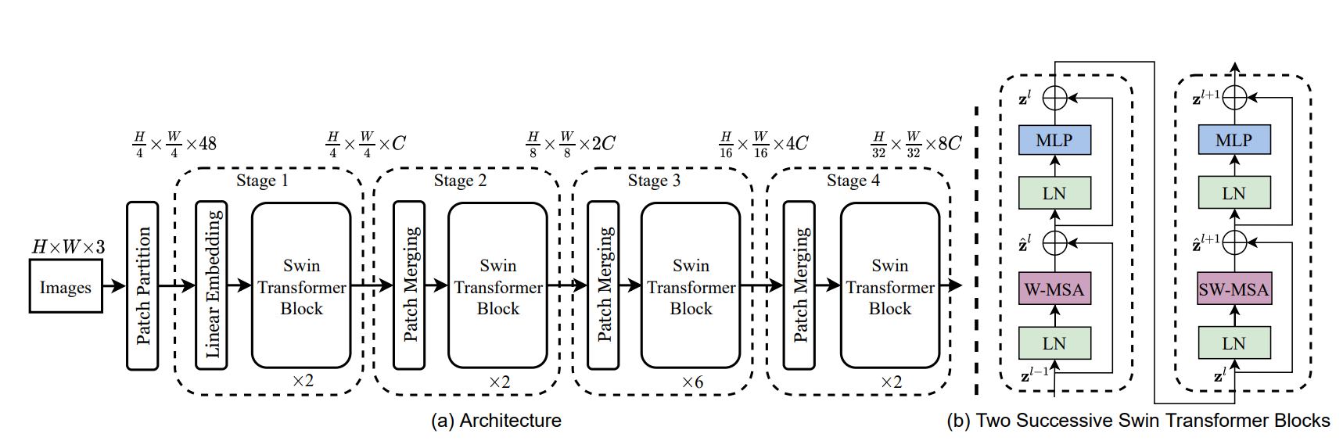
Architecture
Swin Transformer task by 4 stages, stage 1 stack by Linear Embedding and Swin Transformer Block(ST block), other stack by Patch Merging and ST block.
A ST block consist of 2 successive Transformer Encoder block, which alternate the MSA by W-MSA and SW-MSA.

Slide 8
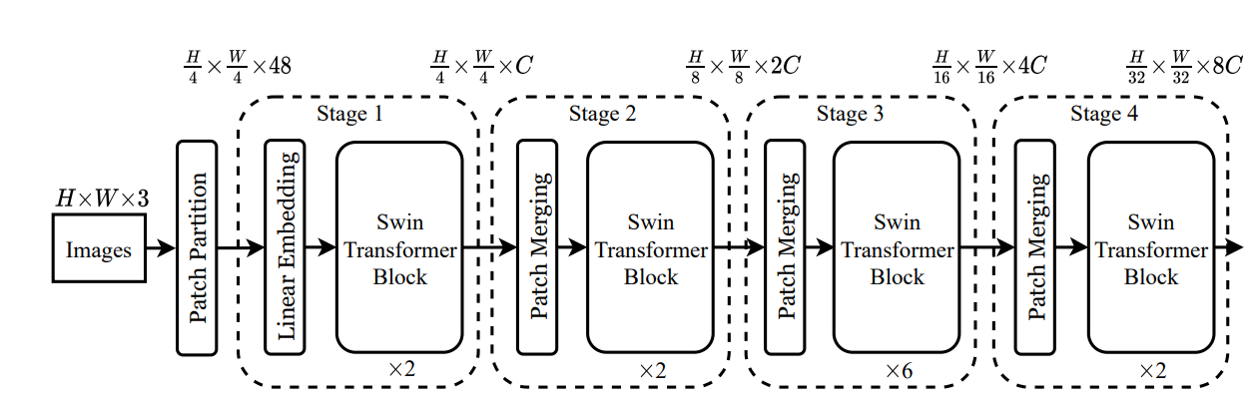
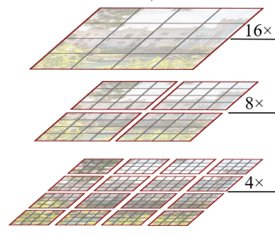
Window-MSA
Merging
Different from ViT and other visual Transformer, Swin Transformer uses the window self-attention to reduce the computing size, which just focus on local patch, and merging these patch on Patch Merging Layer after ST block to get global relation.
Gary means patch, Red means attention window

Slide 9
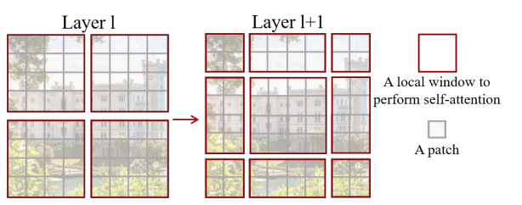
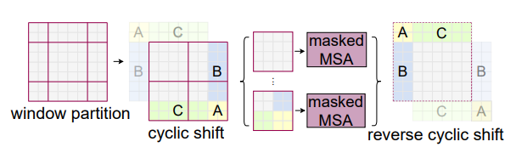
Shifted Window
For get information between neighboring window and reduce the computing size, Swin Transformer uses top-left cyclic shift on Shifted-Window-MSA after Window-MSA.
In Shifted-Window, only identical partition will be computing, different partition in same patch will be masked when computing self-attention.
Notes:
https://blog.csdn.net/weixin_42715977/article/details/124151870

Slide 10
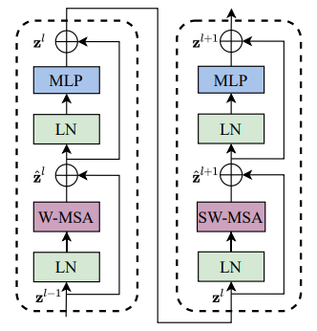
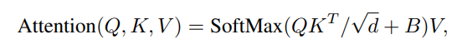
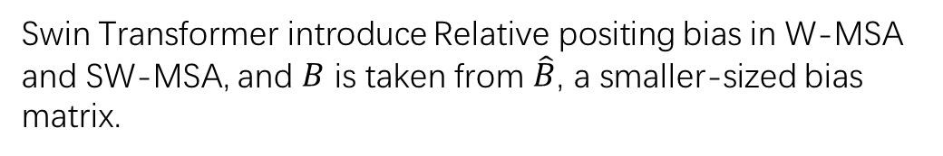
Relative position bias
Swin Transformer introduce Relative positing bias in W-MSA and SW-MSA, and $B$ is taken from $\hat{B}$, a smaller-sized bias matrix.
Notes:
https://blog.csdn.net/qq_37541097/article/details/121119988

Slide 11
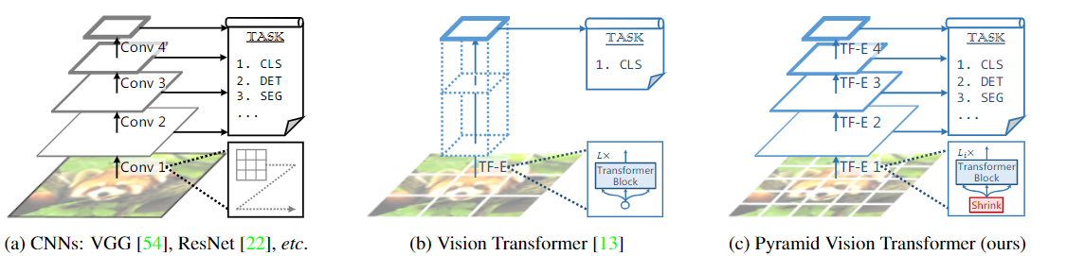
Pyramid Vision Transformer
Feature Pyramid for Transformer
Spatial-reduction Attention
Architecture

Slide 12
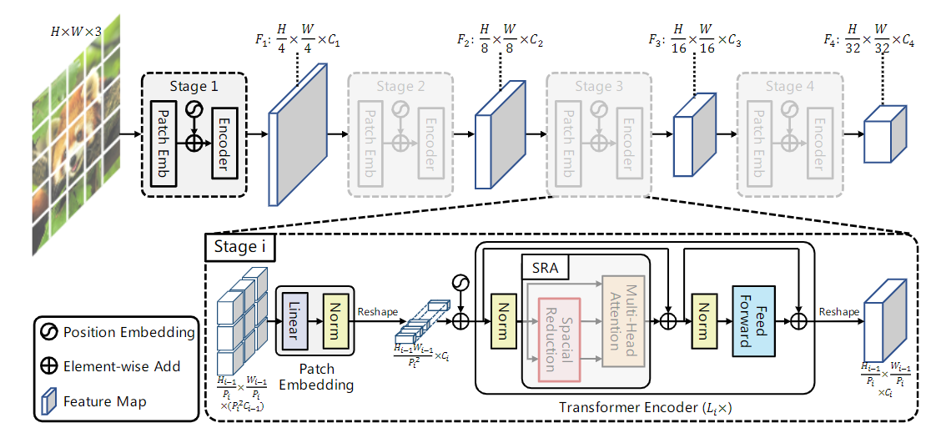
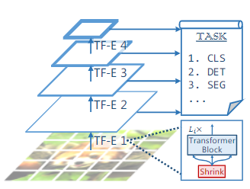
Feature Pyramid for Transformer
Using patch embedding to shrink input feature map

Slide 13
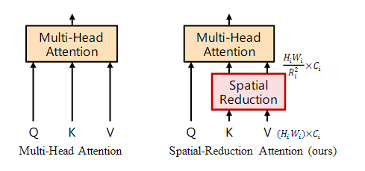
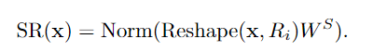



Spatial-reduction Attention
reshape
project
$$X∈R^{(H,W,C)}$$
$$X∈R^{(\frac{H}{r},\frac{W}{r},Cr^{2})}$$
$$X∈R^{(\frac{H}{r},\frac{W}{r},C_{1})}$$

Slide 14
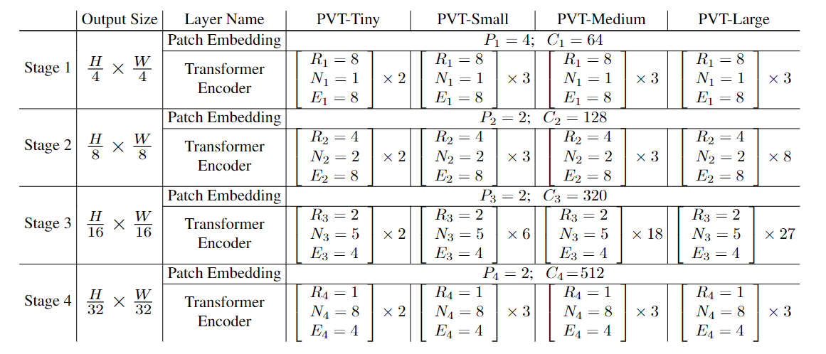
Architecture
• Pi: the patch size of Stage I
• Ci: the channel number of the output of Stage i;
• Li: the number of encoder layers in Stage i;
• Ri: the reduction ratio of the SRA in Stage i;
• Ni: the head number of the SRA in Stage i;
• Ei: the expansion ratio of the feed-forward layer in Stage i;

Slide 15
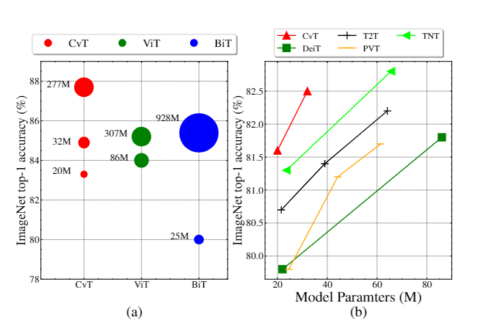
CvT: Introducing Convolutions to Vision Transformers
Convolutional Token Embedding
Convolutional Projection for Attention
Architecture

Slide 16
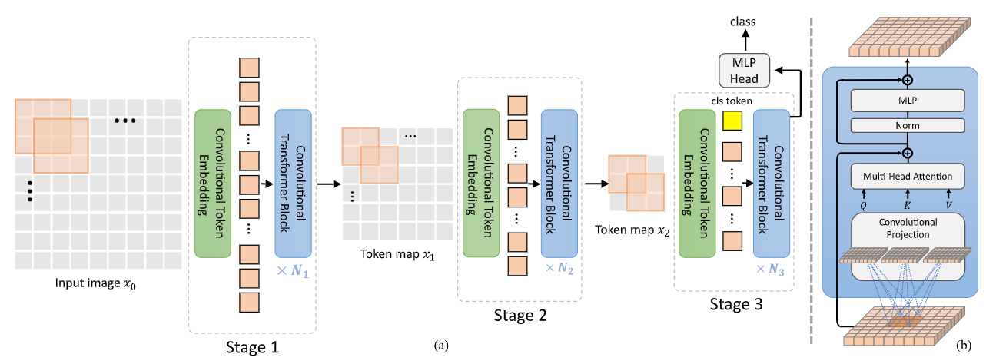
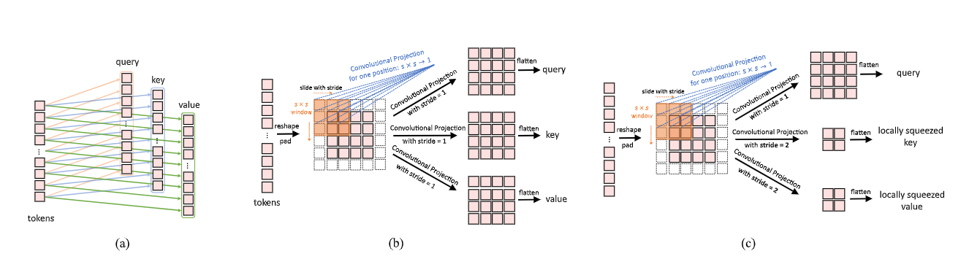
Convolutional Token Embedding
CvT using Convolution Token Embedding to learn local representation, remove Positional Embedding.

Slide 17
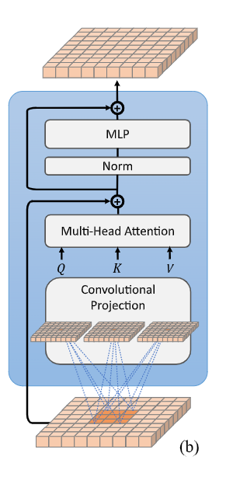
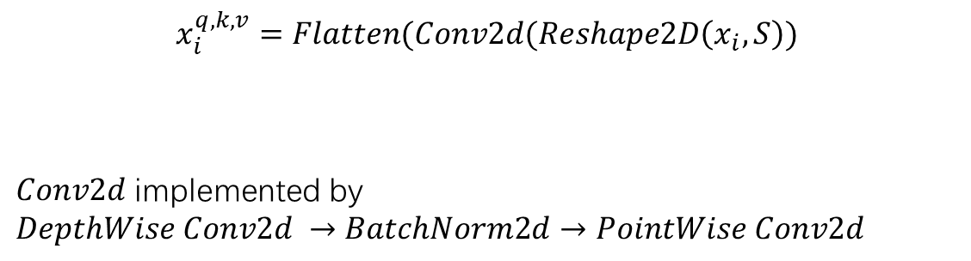
Convolutional Projection for Attention
$$x_{i}^{q,k,v}=Flatten(Conv2d(Reshape2D\left(x_{i},S\right))$$
$Conv2d$ implemented by
$$DepthWise Conv2d →BatchNorm2d→PointWise Conv2d$$

Slide 18
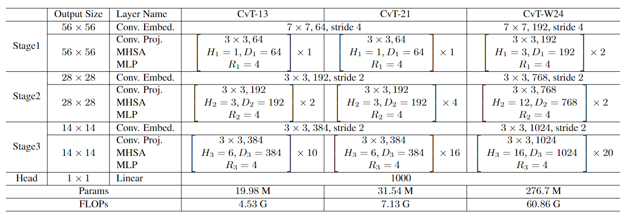
Architecture

Slide 19
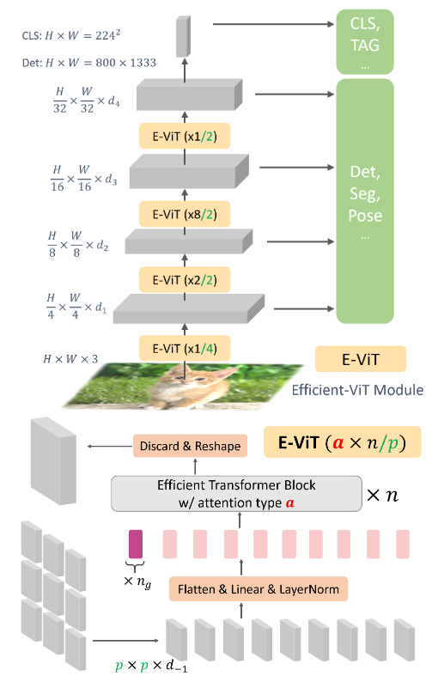
E-ViT : Multi-Scale Vision Longformer: A New Transformer for High-Resolution Image Encoding
Multi-Scale Structure
Attention mechanism of Vision Longformer

Slide 20
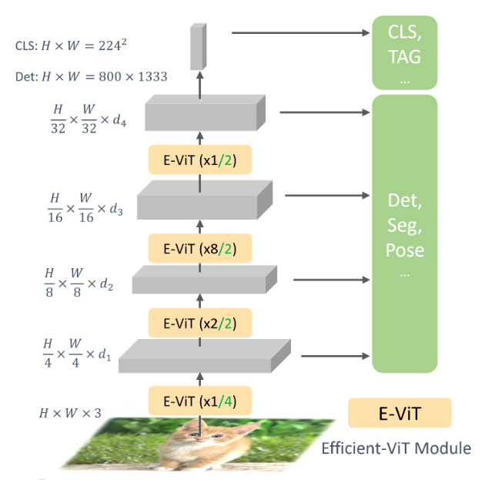
Multi-Scale Structure
Using patch embedding to reduce feature map size.

Slide 21
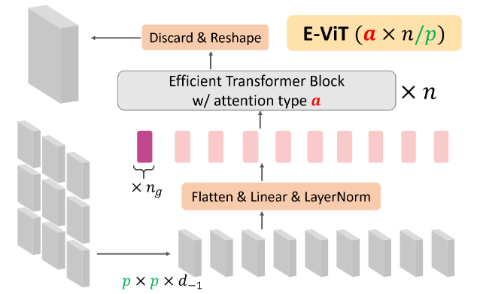
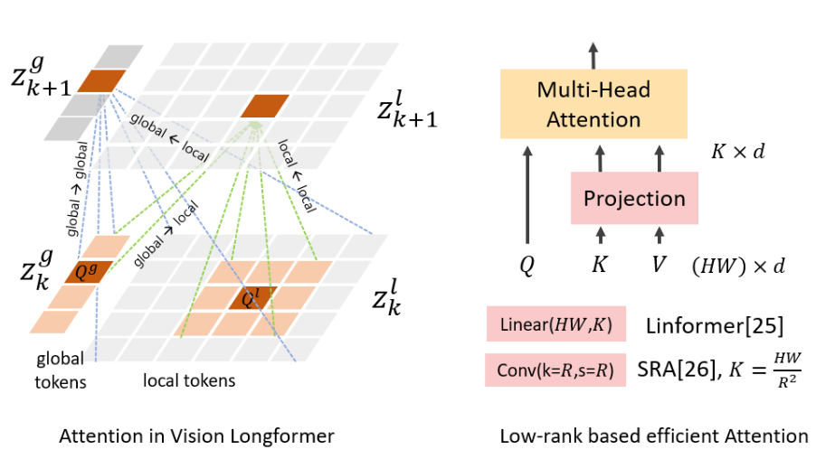
Attention mechanism of Vision Longformer
Introduce global token
Discard globel token in every stage
Local token: image token
Local tokens only focus on local window and global token, while global tokens can attend to all token.

Slide 22
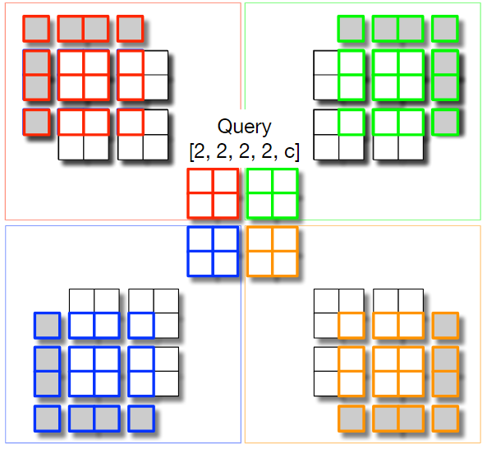
HaloNet: Scaling Local Self-Attention for Parameter Efficient Visual Backbones
Scaling Local Self-Attention
Architecture

Slide 23
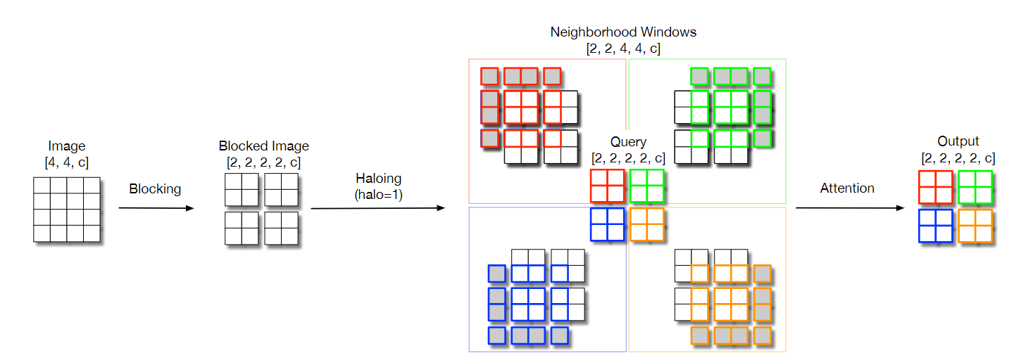
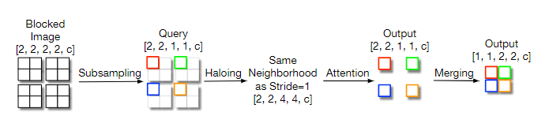
Scaling Local Self-Attention
Halo padding
Attention op in block
Attention op between block

Slide 24
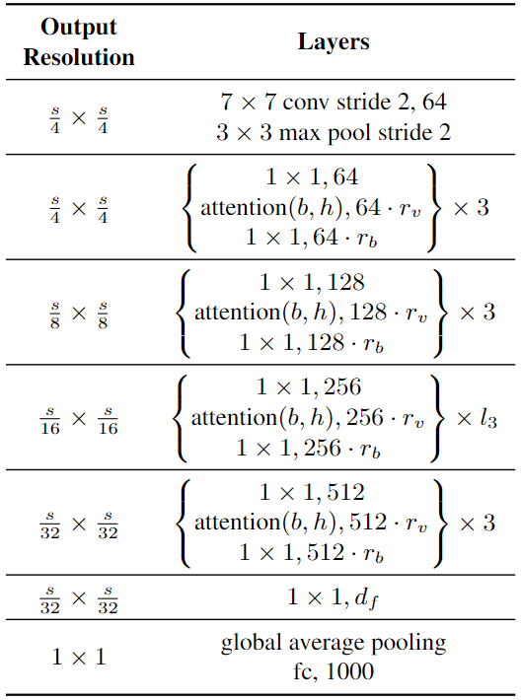
Architecture
As Residual Module, using 1x1 conv op before and after Local Self-Attention op.

Slide 25
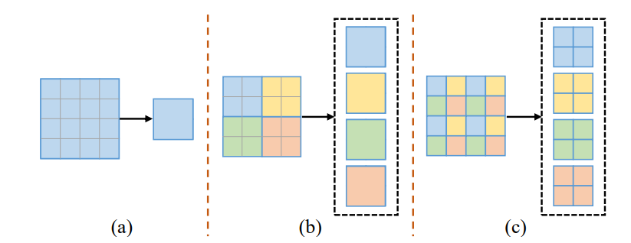
GG-ViT : Glance-and-Gaze Vision Transformer
Glance branch
Gaze branch

Slide 26
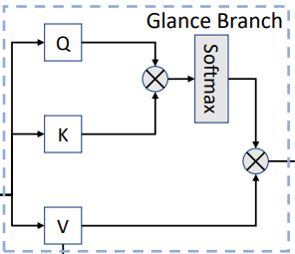
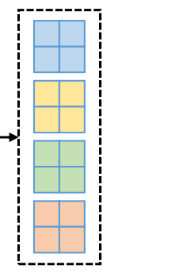
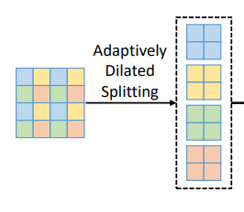
Glance branch
Dilated partitions
Self-Attention in window

Slide 27
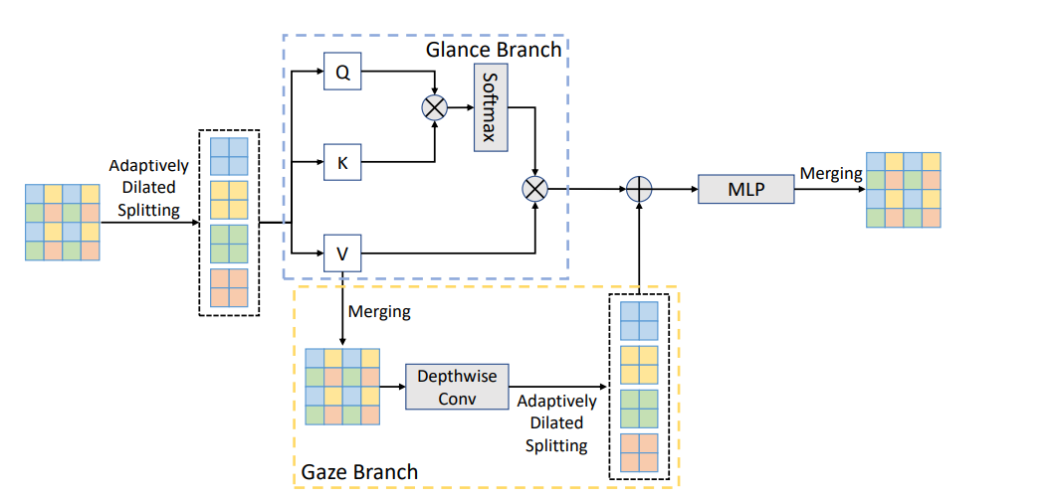
Gaze branch
Obtained global relationship
Obtained local relationship

Slide 28
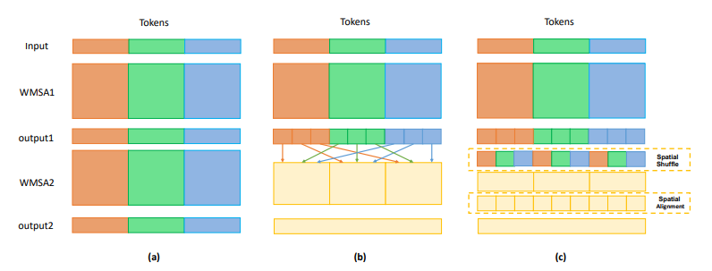
Shuffle Transformer
Cross-Window Shuffle
Shuffle Transformer Block
Architecture

Slide 29
Cross-Window Shuffle

Slide 30
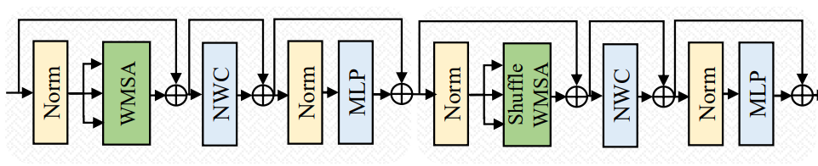
Shuffle Transformer Block
Neighbor-Window Connection, implement by depth-wise conv
Shuffle Window Multi-head Self Attention
Regular Window Multi-head Self Attention

Slide 31
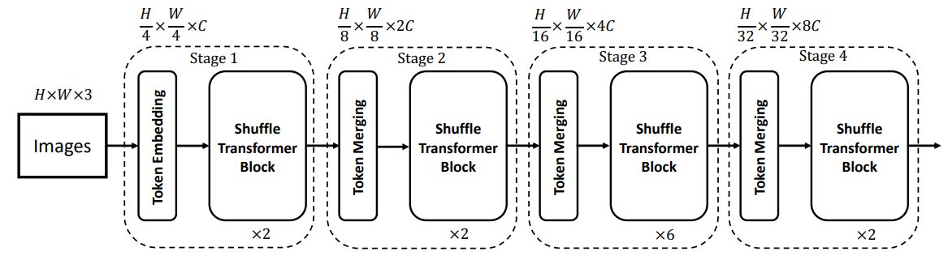
Architecture

Slide 32
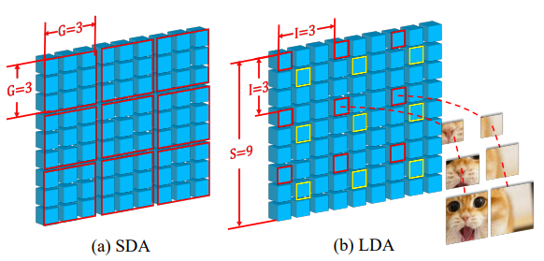
CrossFormer
Cross-scale Embedding Layer
Long Short Distance Attention
Dynamic Position Bias
Architecture

Slide 33
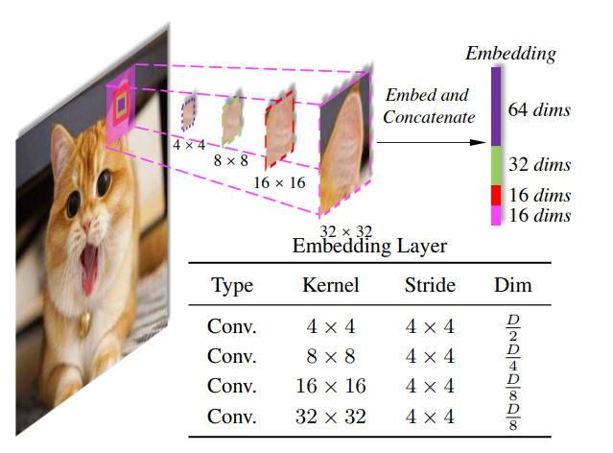
Cross-scale Embedding Layer
Using padding to kept same number of patches

Slide 34
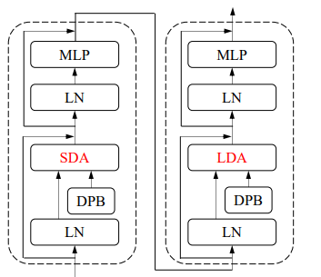
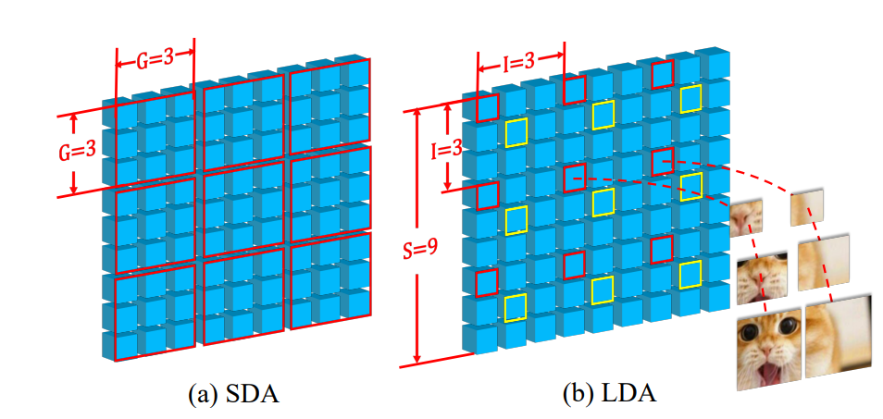
Long Short Distance Attention
Sample different, but using vanilla attention.

Slide 35
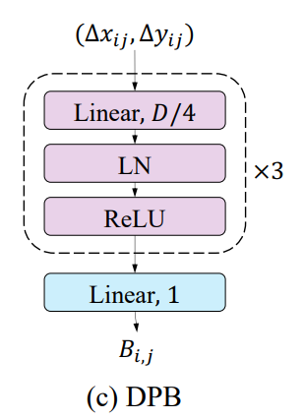
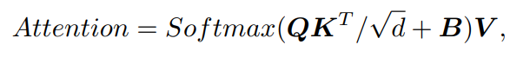
Dynamic Position Bias

Slide 36
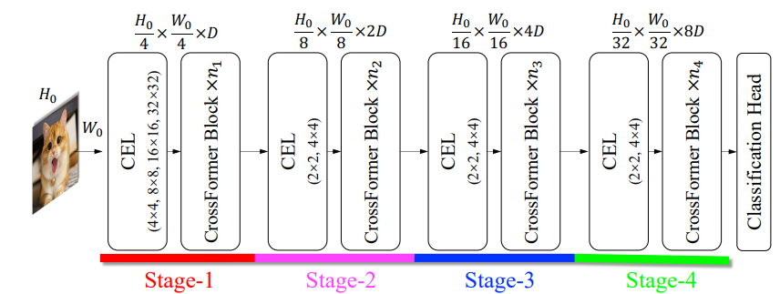
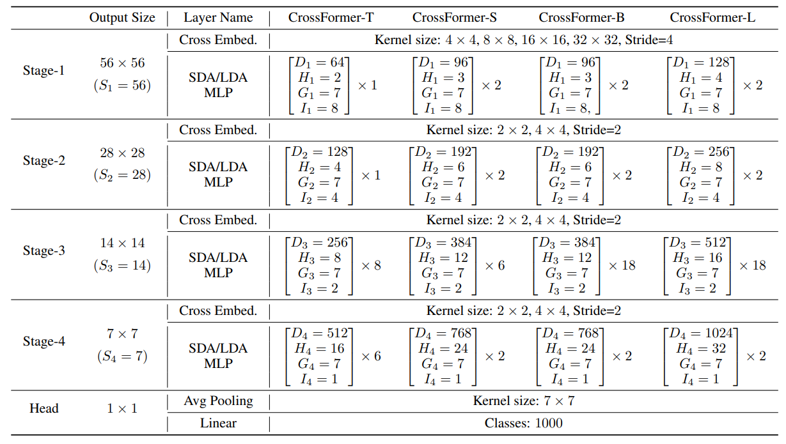
Architecture

Slide 37
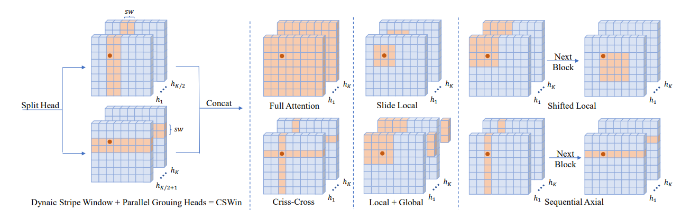
CSWin Transformer
Cross-Shaped Window Attention
CSWin Block
Architecture

Slide 38
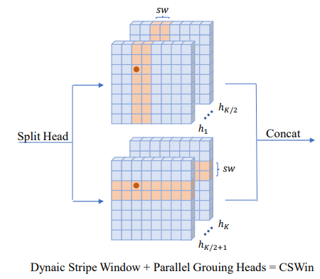
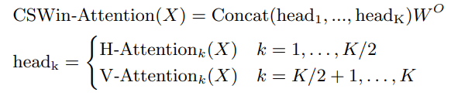

Cross-Shaped Window Attention
Width of stripe will be enlarge in later blocks, one stripe contains $sw ×W$ tokens, which $W$ is width of input feature map

Slide 39


CSWin Block
LePE(Local enhanced position encoding)

Slide 40


Architecture
3x3, stride 2

Slide 41

Mobile-Former
Mobile-Former Block
Architecture

Slide 42



Mobile-Former Block
Multi-head Self Attn
image
Global token, $Z∈R^{M,d}$
2 MLP layers

Slide 43

Architecture
DownSample Mobile-Former Block: has a slightly different Mobile sub-block that includes four convolutional layers: (depthwise→pointwise→depthwise→pointwise),.
where the first depthwise convolution layer has stride 2.

Slide 44

ViTAE: Vision Transformer Advanced by Exploring Intrinsic Inductive Bias
Reduction Cell
Normal Cell
Architecture

Slide 45



Reduction Cell
$$S_{1}=\left[1,2,3,4\right]$$
$$S_{2}=\left[1,2,3\right]$$
$$S_{3}=\left[1,2\right]$$
Multi-path Conv like Inception, concat by channel
$7×7 conv with stride of 4$in first RC, $3×3 conv with stride of 2$ in following two RCs.

Slide 46

Normal Cell

Slide 47

Architecture

Slide 48

CMT: Convolutional Neural Networks Meet Vision Transformers

Slide 49

Neighborhood Attention Transformer
Neighborhood Attention
Architecture

Slide 50

Neighborhood Attention

Slide 51



Architecture

Slide 52

DiNAT: Dilated Neighborhood Attention Transformer
Dilated Neighborhood Attention
DiNAT Block
Architecture

Slide 53



Dilated Neighborhood Attention

Slide 54



DiNAT Block
$$Dilation value δ∈\left[1, \left\lfloor \frac{n}{k}\right\rfloor \right],$$
$$which n is the number of tokens, k is kernel size,$$
$$k=7 in all variants.$$

Slide 55


Architecture
Using dilation value set [8, 4, 2, 1] in ImageNet
Two 3x3 conv with stride of 2
Single 3x3 conv with stride of 2
Double channel dim in Level Downsampler.

Slide 56

UniFormer
Local MHRA
Global MHRA
Architecture

Slide 57


Local MHRA
$$R_{n}=A_{n}V_{n}\left(X\right),$$
$$MHRA\left(X\right)=Concat\left(R_{1}\left(X\right);R_{2}\left(X\right);…R_{N}\left(X\right)\right)U.$$
Which $V_{n}$ is linear transformation, $A_{n}$ is token affinity
$$A_{n}^{local}\left(X_{i},X_{j}\right)=a_{n}^{i−j}$$
$a_{n}^{i−j}$ is a learnable parameter
Local MHRA implement by PWConv-DWConv(5x5)-PWConv

Slide 58

Global MHRA
$$A_{n}^{local}\left(X_{i},X_{j}\right)=\frac{e^{Q_{n}^{}{(X_{i}^{})}^{T}K_{n}^{}{(X_{j}^{})}^{}}}{\sum{e^{Q_{n}^{}{(X_{i}^{})}^{T}K_{n}^{}{(X_{j}^{})}^{}}}}$$

Slide 59

Architecture
4x expand in channel dim
3x3 DWConv

Slide 60

DilateFormer
Sliding Window Dilated Attention
Architecture

Slide 61

Sliding Window Dilated Attention
Using 3x3 kernel size with dilation rate r=[1, 2, 3].
Sizes of attended receptive field are [3x3, 5x5, 7x7]

Slide 62

Architecture

Slide 63

CageViT
Conv Activation Guided Rearrangement
Fusion of Minor Tokens
Gated Linear Spatial Reduction Attention
Architecture

Slide 64

Conv Activation Guided Rearrangement
$$N_{m}=\left\lfloor N_{b}(1−ρ)\right\rfloor$$
Total number of tokens

Slide 65

Fusion of Minor Tokens
Multi-head MLP

Slide 66

Gated Linear Spatial Reduction Attention
Concatenated value of fusion tokens

Slide 67


Architecture

Slide 68



Scale-Aware Modulation Meet Transformer

Slide 69


RMT: Retentive Networks Meet Vision Transformers
Using dec RSA in 1-3 layers

